Slide 1


BOGDAN CONSTANTINESCU
KAI HAYDEN
ROB VOLGMAN
Twitter Sentiment Analysis
for Real-Time Solana Trading
Real Time Intelligent Systems Final Project
2022

Slide 2
01 — Project Overview
02 — Data Cleaning
03 — Data Engineering
04 — Model Training
05 — Trading Strategy
06 — Real-Time Trading
07 — Next Steps
Contents
2021

Slide 3
BOGDAN CONSTANTINESCU
KAI HAYDEN
ROB VOLGMAN
Project Overview
01
REAL TIME INTELLIGENT SYSTEMS FINAL PROJECT

Slide 4
Why This Project?
Cryptocurrency trading volumes have skyrocketed to as high as $300B USD/day
With no underlying asset, cryptocurrency valuations are often volatile and “hype-driven”
Twitter activity can signal both positive and negative interest in a coin.
Viral tweets can often have an near-immediate effect on the market
The goal of this project is to create a profitable real time trading system that can generate signals in real time based on the sentiment of a tweet.

Slide 5
Project Steps
Data
Collection
Data Engineering
Model
Training
Trading
Strategy
Real-Time Trading
Twitter API for historical tweet data
CryptoCompare API for historical Solana price data
Binance API for live Solana price data
Label tweets with 24h trailing return
Tokenize historical and real time tweets to standardize length
Train LSTM model on two weeks of historical data
Predict 24-hour returns
Utilize sentiment analysis to predict price movement
Transform price predictions into trading signals
Stream Twitter data in real-time
Generate trading signals and track PNL
Execute long/buy and short/sell orders
Notes:
The project is organized into five steps.
Step 1 is Data Collection.

Slide 6
BOGDAN CONSTANTINESCU
KAI HAYDEN
ROB VOLGMAN
Data
Collection
02
REAL TIME INTELLIGENT SYSTEMS FINAL PROJECT

Slide 7




Data Collection with APIs
Twitter Data
Developer account with elevated access to Twitter API
Tweepy library to access the Twitter API through Python
Search_recent_tweets function to collect historical tweets
Stream.filter function to stream tweets in real time
Price Data
Cryptocompare web-socket API to collect historical Solana price data
From symbol - SOL
To symbol - USD
Binance web-socket API to collect real time Solana price data
From symbol - SOL
To symbol - USDT

Slide 8
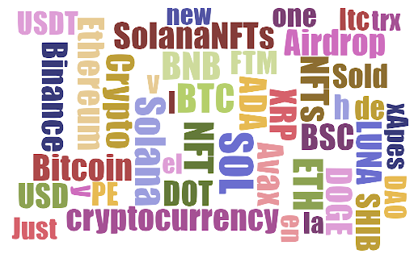
Text Analysis

Slide 9
BOGDAN CONSTANTINESCU
KAI HAYDEN
ROB VOLGMAN
Data
Engineering
03
REAL TIME INTELLIGENT SYSTEMS FINAL PROJECT

Slide 10
Data Engineering
Associate tweet with 24-hour trailing returns minute-by-minute
Remove punctuation and tokenize vectors on most common 1000 words to limit overfitting small samples
Embedding layer to reduce input dimensionality
Split train and test sets by time to avoid data leakage
Time | Followers | Text
2022-03-11 20:16:43 | 21880 | Whats the highest price your favorite [...]
2022-03-11 20:16:44 | 17 | This project is going to be great [...]
+
Time | Close | Move | Percent
2022-03-11 20:16:00 | 80.68 | 1.11 | 0.013758
2022-03-11 20:17:00 | 80.78 | 1.05 | 0.012998
↓
Time | Followers | Text | Returns
2022-03-11 20:16:43 | 21880 | Whats the highest price your favorite [...] | 0.012998
2022-03-11 20:16:44 | 17 | This project is going to be great [...] | 0.012998

Slide 11
BOGDAN CONSTANTINESCU
KAI HAYDEN
ROB VOLGMAN
Model Training
04
REAL TIME INTELLIGENT SYSTEMS FINAL PROJECT

Slide 12
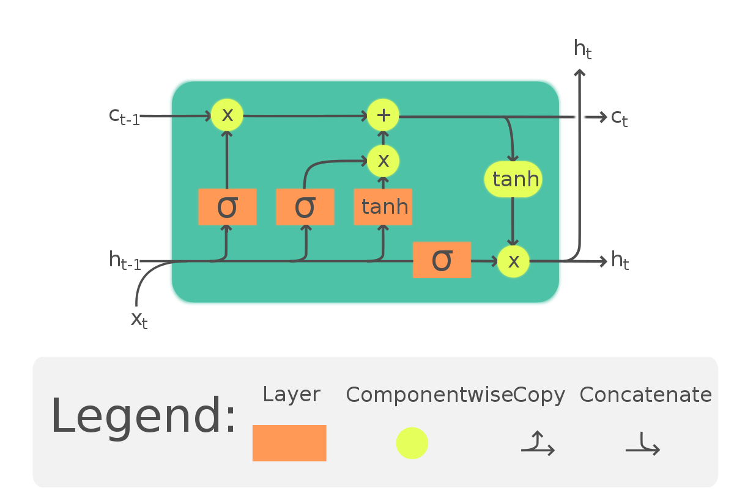
Model Selection
LSTM
Allows us to associate words with price movement
Long short-term memory (LSTM) models are a form of recurrent neural network with the ability to retain information over long sequences
When applied to text recognition, allows for pattern recognition of phrases or word combinations separated by long stretches
Implemented using the Keras library with MSE loss function, adam optimizer

Slide 13
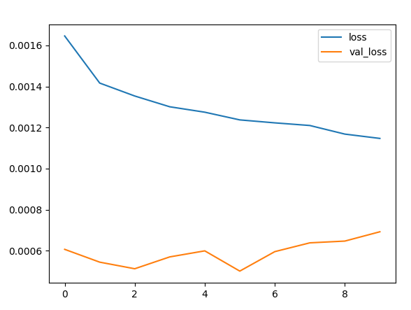
Model Training
Training set of 13,000 Tweets collected over 2 weeks
Validation set time frame had significantly lower variance than training set
Training beyond 5 epochs did not improve validation loss
5 epochs used for final model

Slide 14
Model Predictions
Positive
Negative
Memecoin
Pengoicy
Airdrop
Project
Ada
Xrp
Nftart
Bnb
Binance
Avax
Cro
Tez
Shill
Chill
Poly

Slide 15
BOGDAN CONSTANTINESCU
KAI HAYDEN
ROB VOLGMAN
Trading Strategy
05
REAL TIME INTELLIGENT SYSTEMS FINAL PROJECT

Slide 16
Sentiment Interpretation
Read Market Data
Generate Sentiment
Sm_Avg
Average sentiment score over a small window
Lg_Avg
Average sentiment score over a large window
shift small window 1 step forward shift large window 1 step forward
yes
no
Sm_Avg > 0
Sm_Avg > Lg_Avg
Sm_Avg < Lg_Avg
yes
no
no
yes
Evaluate Signal
Strong Buy
Weak Buy
Weak Sell
Strong Sell

Slide 17
Trading Algorithm
Evaluate Signal
Strong Buy
Weak Buy
Weak Sell
Strong Sell
Set Target Position
2 × scaler × Sm_Avg
× log(followers)
scaler × Sm_Avg × log(followers)
scaler × Sm_Avg × log(followers)
2 × scaler × Sm_Avg
× log(followers)
Set Order Size
Target Position - Current Position
Target Position - Current Position
Place Buy Order
Place Sell Order

Slide 18
BOGDAN CONSTANTINESCU
KAI HAYDEN
ROB VOLGMAN
Real-Time Trading
06
REAL TIME INTELLIGENT SYSTEMS FINAL PROJECT

Slide 19
Real-Time Trading
Trading Strategy Class
Twitter Stream Class
Track positions, cash, holdings, profits and losses
Define trading strategy and initialize parameters
Instantiate queues to record tweet sentiment
Create a real time twitter stream instance
Parent class inheriting tweepy.Stream
Establish a streaming connection with Twitter API
Start and stop streaming tweets based on its trading strategy superclass instance
Trade method to connect to twitter stream and begin trading
On_market_update method to generate signal
Check_signal method to execute orders
Extract tweet fields in real time
Perform sentiment analysis on extracted text
Pass an update containing sentiment, price, and followers to the trading system
Stop method to disconnect from twitter stream and stop trading
Close current position and liquidate all holdings
Disconnect from twitter stream
Pass a “disconnect update” to instruct trading system to close position at current price

Slide 20
BOGDAN CONSTANTINESCU
KAI HAYDEN
ROB VOLGMAN
Next Steps
07
REAL TIME INTELLIGENT SYSTEMS FINAL PROJECT

Slide 21

Next Steps
Gather tweets over a larger time frame and on multiple cryptocurrencies
Gather data from other sources
Reddit
News
Discord
Telegram
Explore whether phrase patterns and tweet activity translate across cryptocurrencies or are unique to each currency
Utilize model predicted risk and return to refine sizing
Alternative models (GRU, BERT)

Slide 22
BOGDAN CONSTANTINESCU
KAI HAYDEN
ROB VOLGMAN
Real-Time Demo
REAL TIME INTELLIGENT SYSTEMS FINAL PROJECT

